Slide 1
iSAM2: Incremental Smoothing and Mapping using the Bayes Tree
Vidula Kopli

Slide 2
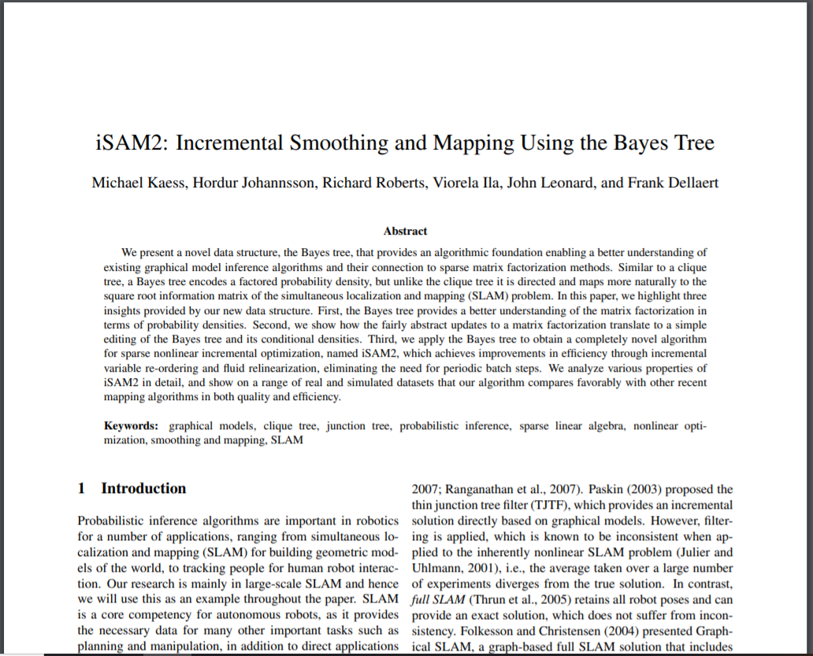




Paper
Michael Kaess, CMU
Robot Perception Lab
The International Journal of Robotic Research
iSAM (2008) → iSAM2 (2011)

Slide 3
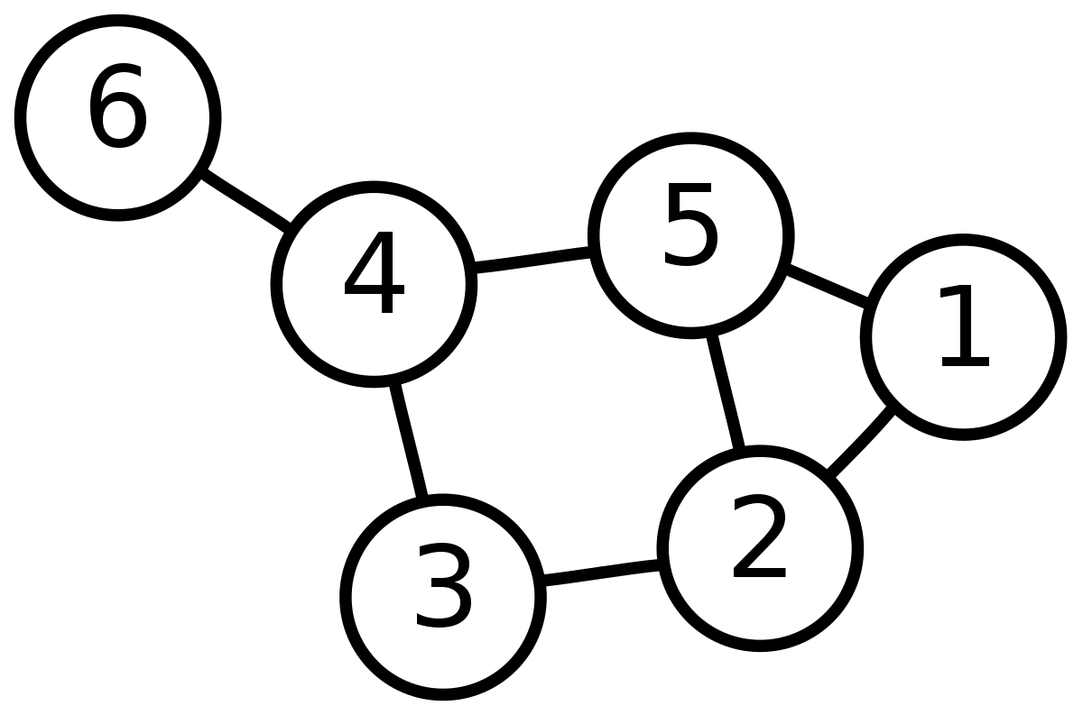
Intro to Graph THEORY

Slide 4
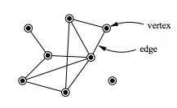
Graph Definition
A graph is an ordered pair G = (V, E ) comprising of:
A set of vertices V (a.k.a. nodes)
A set of edges E ⊆ {{x, y} | (x, y) ∈ V² ∧ x ≠ y}

Slide 5
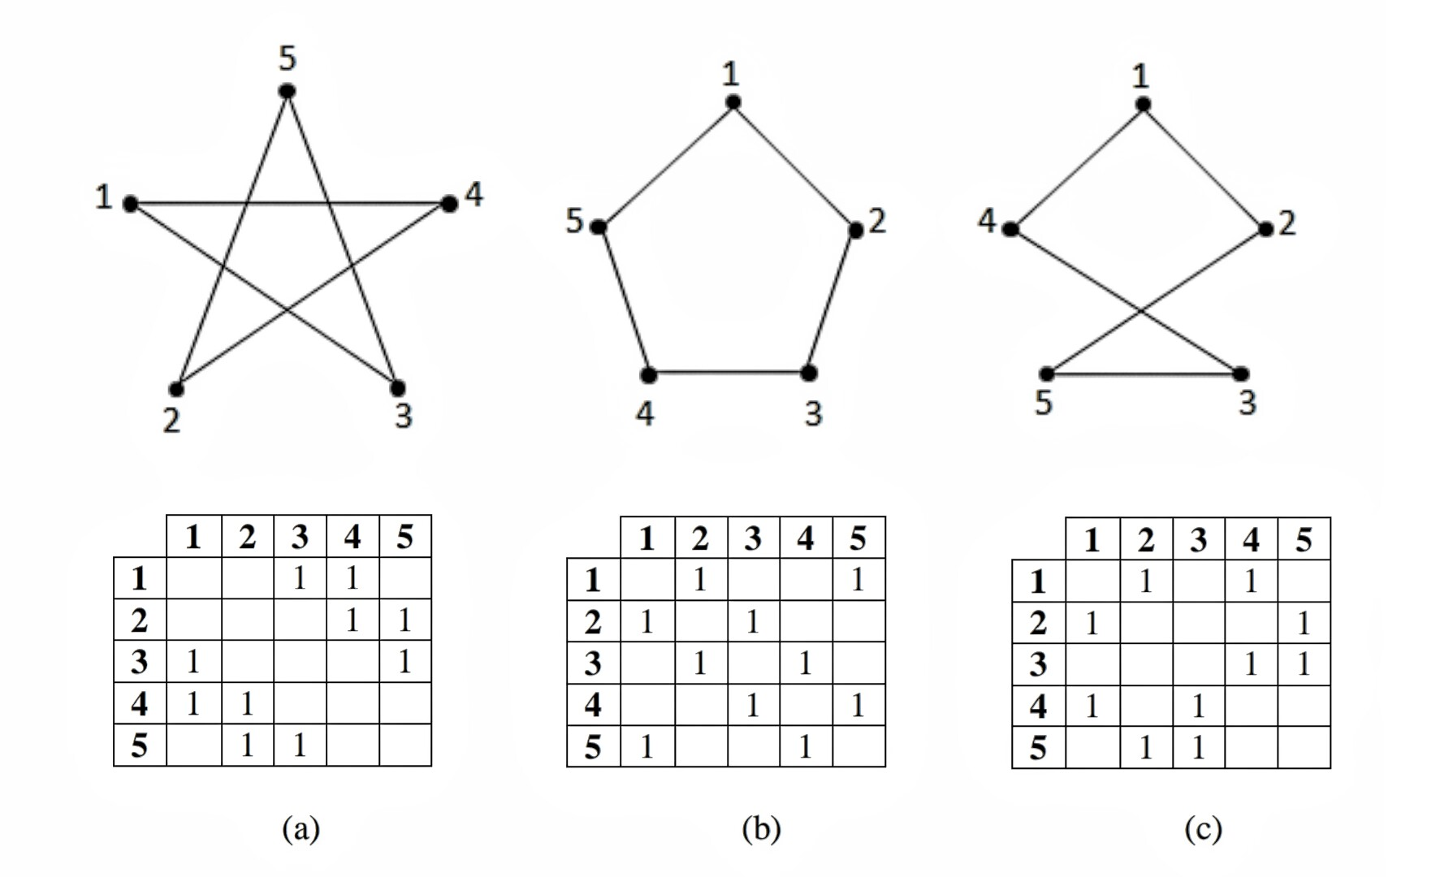
Adjacency
Two vertices are adjacent if there is an edge between them
Adjacency Matrix: matrix representation of graph

Slide 6
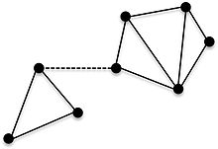
Connectedness
A graph is connected when it has at least one vertex and there is a path between every pair of vertices
A path is a finite or infinite sequence of edges which joins a sequence of distinct vertices
If this edge were removed, the graph would become disconnected.

Slide 7
Cliques
Clique: a subset of vertices such that every 2 distinct vertices are adjacent.
Maximal clique: a clique that can’t be extended by adding one more adjacent vertex
Question: How many maximal cliques are in this graph?

Slide 8
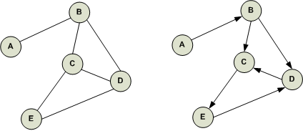
Directed Graphs
The set of edges E is a set of ordered pairs of vertices:
Undirected graph: E ⊆ {{x, y} | (x, y) ∈ V² ∧ x ≠ y}
Directed graph: E ⊆ {(x, y) | (x, y) ∈ V² ∧ x ≠ y}
Undirected
Directed

Slide 9
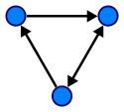
Cycles
A cycle in a graph is a non-empty trail in which the only repeated vertices are the first and last vertices
A trail is a finite or infinite sequence of edges which joins a sequence of distinct edges
In a directed graph, this trail only follows arrows in the specified direction
3-vertex cycle

Slide 10
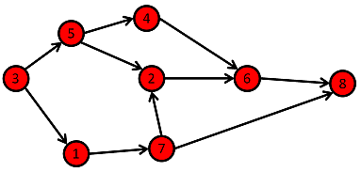
Cyclic Graphs & Trees
A cyclic graph is a graph containing at least 1 cycle
Question: What is the cycle in this graph?
Answer: (2, 1, 7, 2)
Directed Cyclic Graph

Slide 11
Cyclic Graphs & Trees
*Directed Acyclic Graph = DAG
An acyclic graph is a graph containing no cycles
An acyclic graph is a tree if the graph is connected
Connected DAG* (Tree)

Slide 12
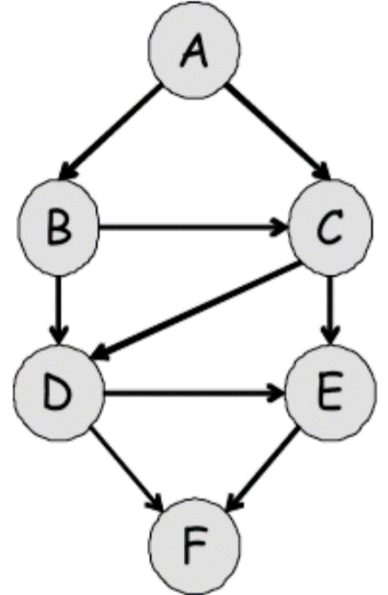
Clique Trees
1
Assume graph H is chordal
Any 4-vertex cycle has an edge that is not in the cycle
A tree T is a clique tree for H if:
Each node corresponds to a clique in H
The overlapping vertices of 2 cliques separate the cliques (the cliques are conditionally independent)
Question: What is the clique tree of the graph to the right?
2
3
4
ABC → BCD → CDE → DEF

Slide 13
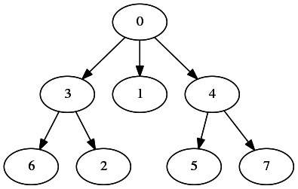
Rooted (Directed) Trees
Root
Assign to one node
No incoming edges
Leaf
No outgoing edges
Parent, Children
Parent’s outgoing edges point to children
Root
Parent
Leaf
Leaf
Leaf
Leaf
Leaf
Child
Child

Slide 14
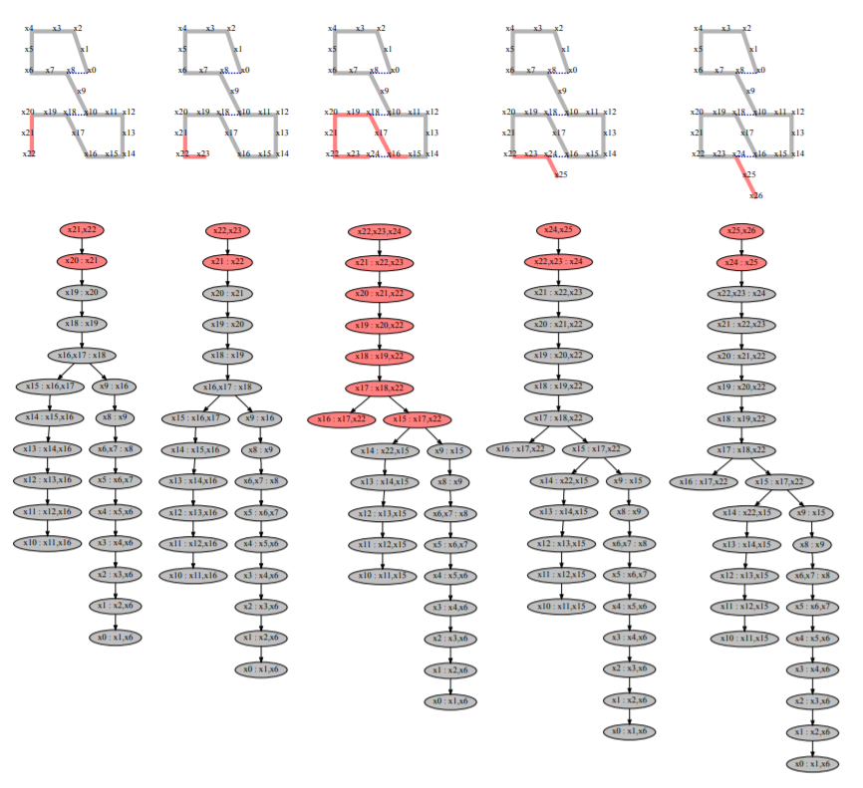
Graph Concepts In ISAM2

Slide 15
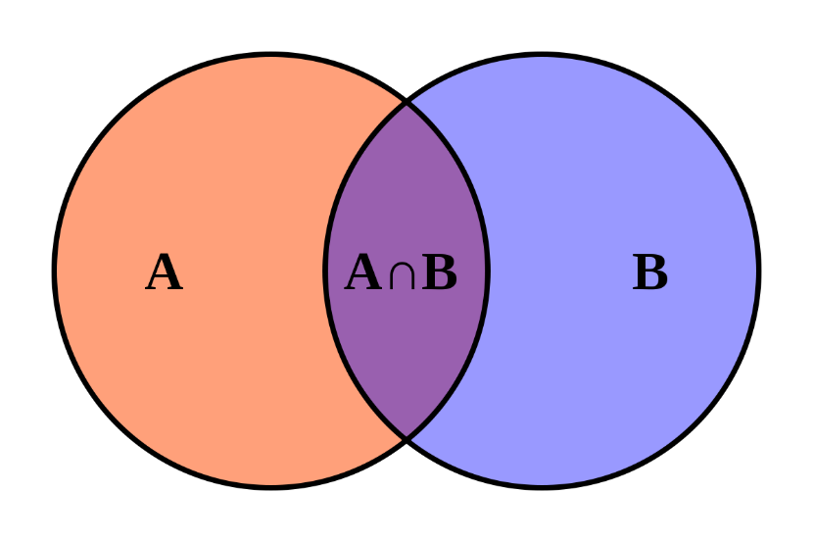
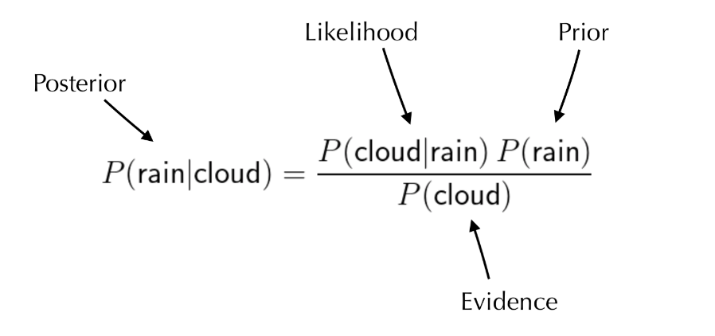
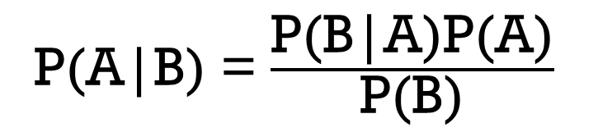
Probability
Definition of Conditional Probability
Bayes Theorem
P(A|B) = $\frac{\text{P}\text{(}\text{B}\text{|}\text{A}\text{)}\text{P}\text{(}\text{A}\text{)}}{\text{P}\text{(}\text{B}\text{)}}$
P(A∩B) = P(A|B)P(B)
Random Variables (RV’s)

Slide 16

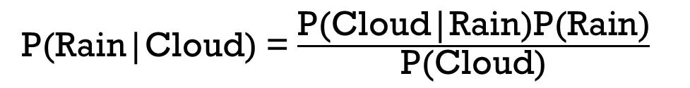
Bayes Theorem
P(Cloud|Rain)
P(Rain|Cloud)
Cloud
Rain
Cloud
Rain
Prior Distribution
P(Rain) = 0.1
P(Cloud) = 0.4
Conditional probability
P(Cloud|Rain) = 0.5
Question: What is the probability that it will rain if it is cloudy?
P(Rain|Cloud) = $\frac{\text{0.5 }×\text{ 0.1}}{\text{0.4}}$ = 0.125
Check Answer:
P(Rain∩Cloud) = P(Rain|Cloud)P(Cloud)
= P(Cloud|Rain)P(Rain)
= 0.05
P(Rain|Cloud) = $\frac{\text{P}\text{(}\text{Cloud}\text{|}\text{Rain}\text{)}\text{P}\text{(}\text{Rain}\text{)}}{\text{P}\text{(}\text{Cloud}\text{)}}$

Slide 17
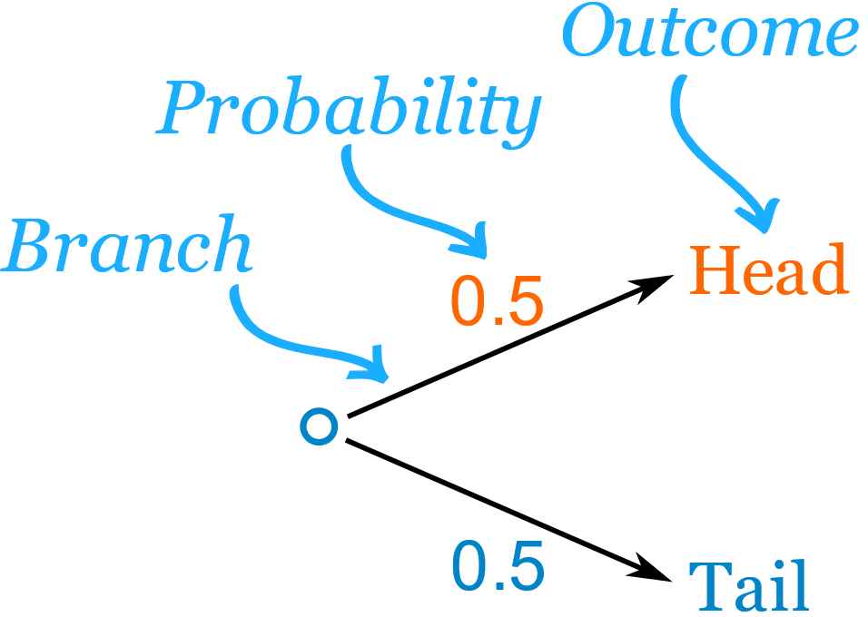
Graph Models of Probability
Joint Probability distribution: probability of every possible event as a combination of all possible RV’s
Must represent part of joint probability distribution w/ independence relationships
Examples:
Modified Decision Trees (to right)
Bayes Nets
Factor Graphs

Slide 18
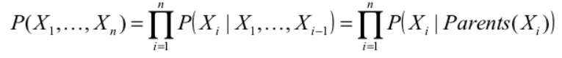
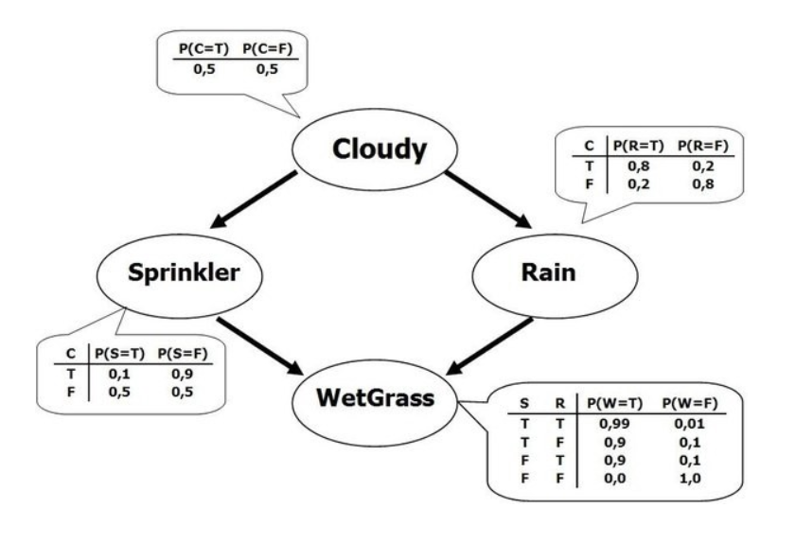
Bayes Nets
DAG
Nodes
Factorization ↔ Conditional Independence
Prior
P(Cloudy)
Joint Probability Distribution
P(Cloudy,Sprinkler,Rain,WetGrass)
* a.k.a. local probabilistic model
Conditional Probability Distribution
of WetGrass given its Parents
P(WetGrass|Sprinkler,Rain)
Independence Relationships

Slide 19
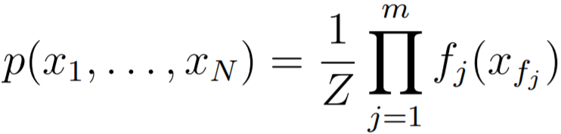
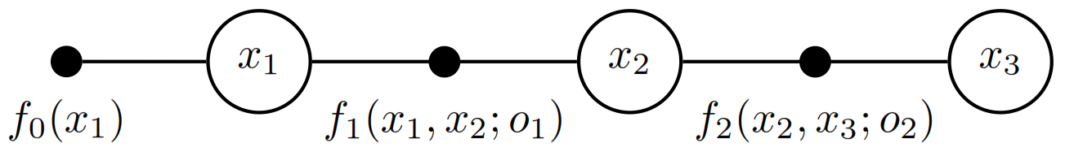
FactoR Graphs
A factor graph is a bipartite graph G = (X, F, E ) comprising of:
A set of variable vertices X
A set of factors F
A set of edges E
Representing a joint probability distribution
Each variable can be range of values
Each factor assigns weights/confidences on relationship between values
A variable can be held to a value using a unary factor (prior) (e.g. o₁, o₂)

Slide 20
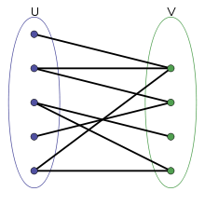
Bipartite Graphs
x₁
x₂
x₃
Bipartite graph: A graph whose vertices can be divided into 2 disjoint and independent sets U and V such that every edge connects a vertex U to one in V.
Question: How is the factor graph above a bipartite graph?
U
V
F
X
x₁
x₂
x₃

Slide 21
Conditional Independence
If every path between the vertices X and Y contains a vertex V ∈ V :
X is conditionally independent of Y given V
V separates X from Y
Question: Given this graph, P(A|B,C) = P(A|?)
Question: What does this mean for clique trees?
P(A|B)
A
B
C
Chordal Graph H
Clique Tree of H
Represent conditional independence/factorization compactly
C
E
CDE
DEF
ABC
BCD
A
F
P(F|A,B,C,D,E) = P(F|D,E)
B
D

Slide 22
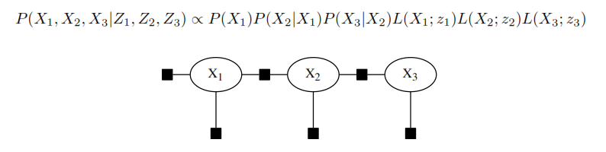
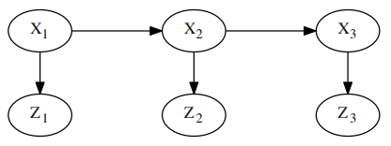

Example: Factor Graph ↔ Bayes Net
prior
Factor Graph
root
Bayes Net

Slide 23
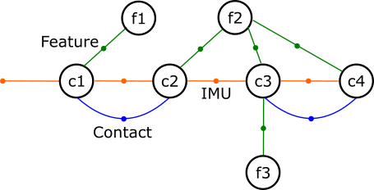
Factor Graphs: SLAM
Variables (Value = 3D Pose/Position)
c1 - camera at time t=1
f1 – features found by camera at time t=1
Binary Factors
Relate variables to each other
E.g: Feature, Contact, IMU
Unary Factors (Priors)
Anchor variables whose
pose/position is known

Slide 24
Respresenting Measurement Noise
Covariance for each factor category (e.g. IMU, GPS)
Represents uncertainty in measurement
IMU
GPS

Slide 25
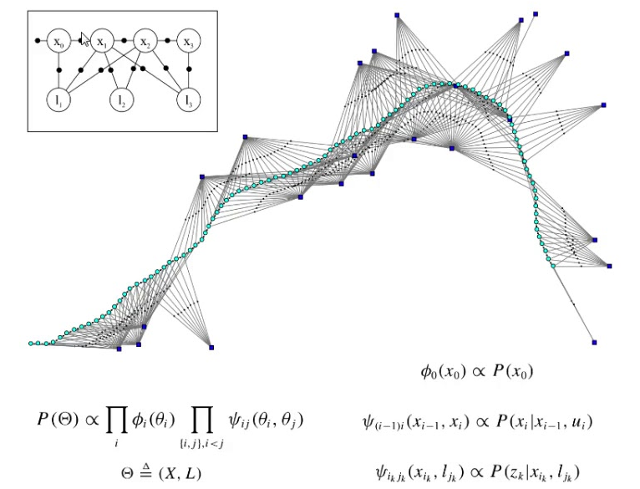
iSAM2 Algorithm

Slide 26
Algorithm
t = 1
t = 2
x₁
x₂
x₃
For each iteration:
1. Add information from current timestep to graph
Set initial estimate for new variables
Define factors connecting those variables
2. iSAM2 updates values of variables in graph
Continually reduce complexity → solve nonlinear eq.
Full SLAM: Levenberg-Marquardt optimization
t = 3

Slide 27
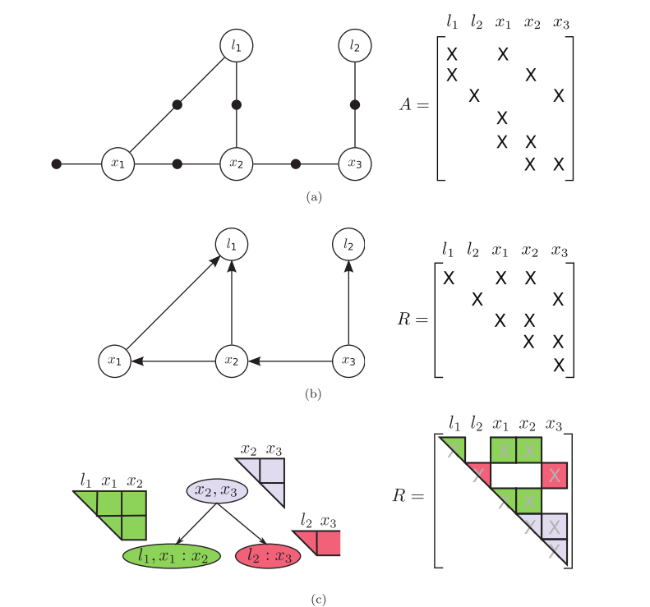
Adding new
information
1. Factor Graph
2. Elimination
(Chordal Bayes Net)
Graph Representation
3. Bayes Tree
ISAM2 updates

Slide 28
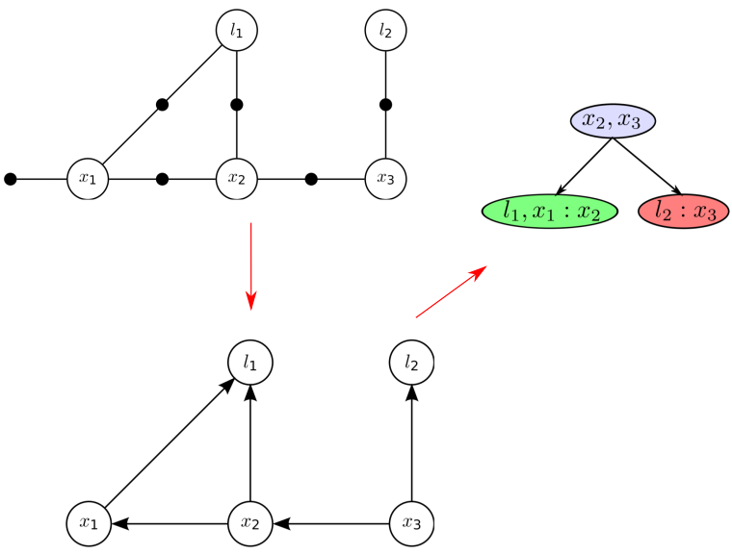
2. Chordal Bayes Net (Elimination)
Add edges to induce perfect elimination ↔ graph is chordal
Elimination Ordering: l₁, l₂, x₁, x₂, x₃
Root: last vertex to be eliminated
Joint Density (Global) → Conditional Probabilities (Local)
Factor Graph
Chordal Bayes Net

Slide 29
3. Bayes Tree*
*Similar to Clique Tree from earlier
Vertices represent cliques of the Chordal Bayes Net
Clique definition slightly modified to maintain semantic meaning of conditionals
Separator of clique is to right of semicolon (:)
Every path to vertices in the clique must go through the separator
Chordal Bayes Net
Bayes Tree

Slide 30
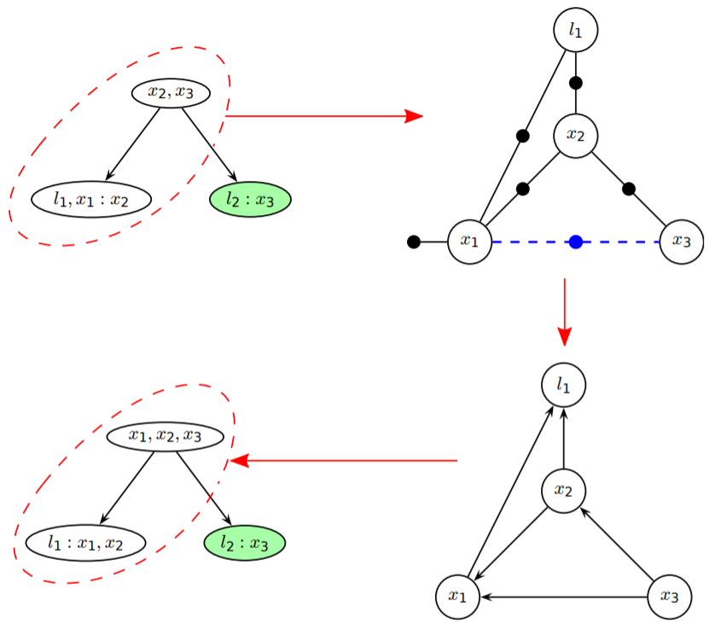
Graph Updates on Bayes Tree
x₂, x₃
Adding factors:
Only vertices leading up to root updated
Edge is added x₃ → x₁
x₂ no longer only separator for l₁
x₁ on possible path to l₁
l₁, x₁: x₂
x₁, x₂, x₃
l₁: x₁, x₂

Slide 31
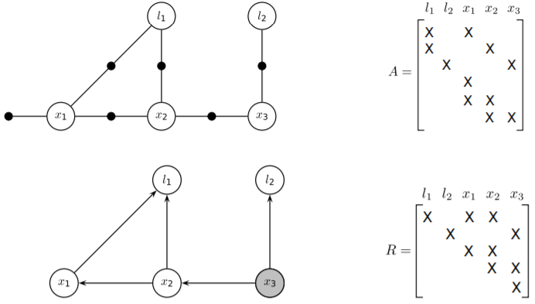
Graph-Matrix Equivalences
Factor Graph Elimination ~ Matrix Factorization
Jacobian
Square Root
Information
Matrix

Slide 32
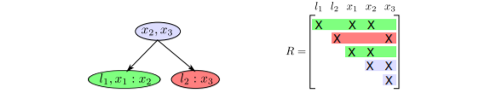
Graph & Matrix Optimization Correspondences
Bayes Tree Model ↔ Sparse linear algebra
Reduced set of variables ↔ Sparseness
Simple editing of Bayes Tree ↔ Abstract updates to matrix factorization
Directed edges/conditionals ↔ QR/Cholesky factorization
Square Root
Information
Matrix
Bayes Tree

Slide 33
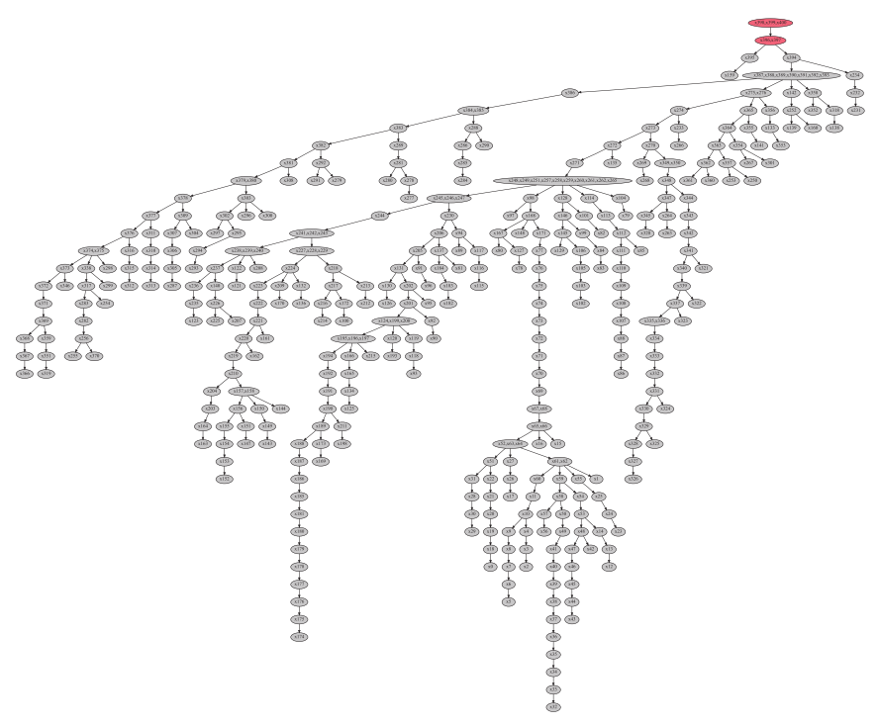
Efficiency
Bayes Tree only requires some vertices to be updated
Maintain sparse matrix → less complexity
Avoid redundancy that matrix update equations have
Variable reordering & relinearization done while updating Bayes Tree
Maintain smaller cliques → more efficient computation
Full solution rather than estimate

Slide 34
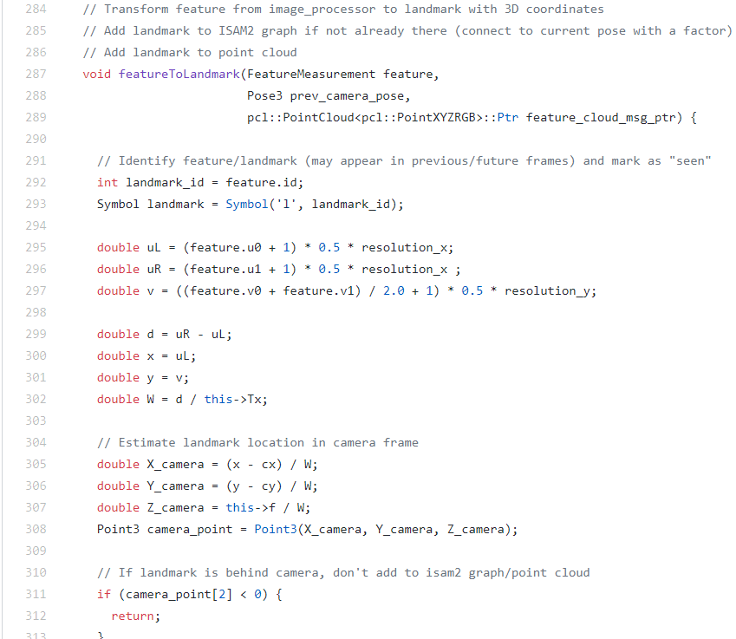
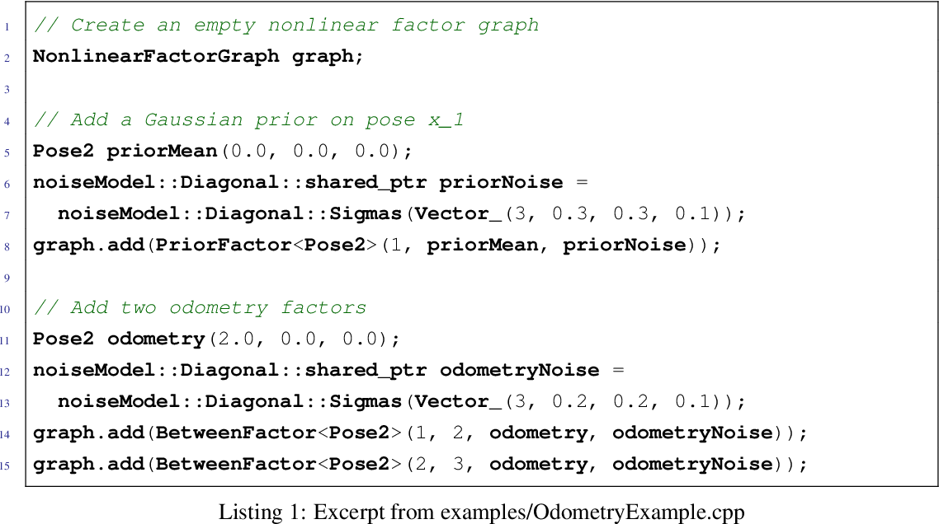
My Experience
Notes:
Maybe put printed bayes tree in this slide

Slide 35
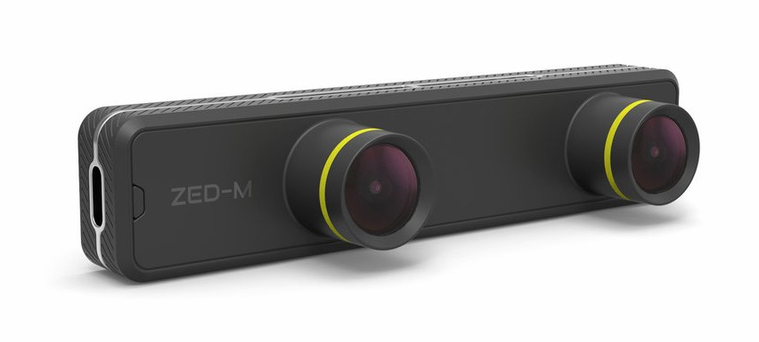
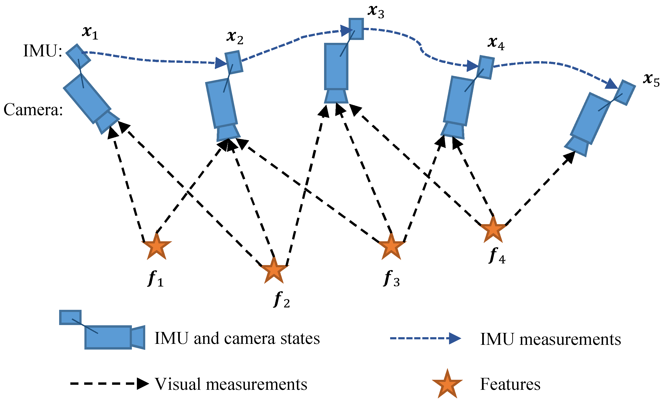
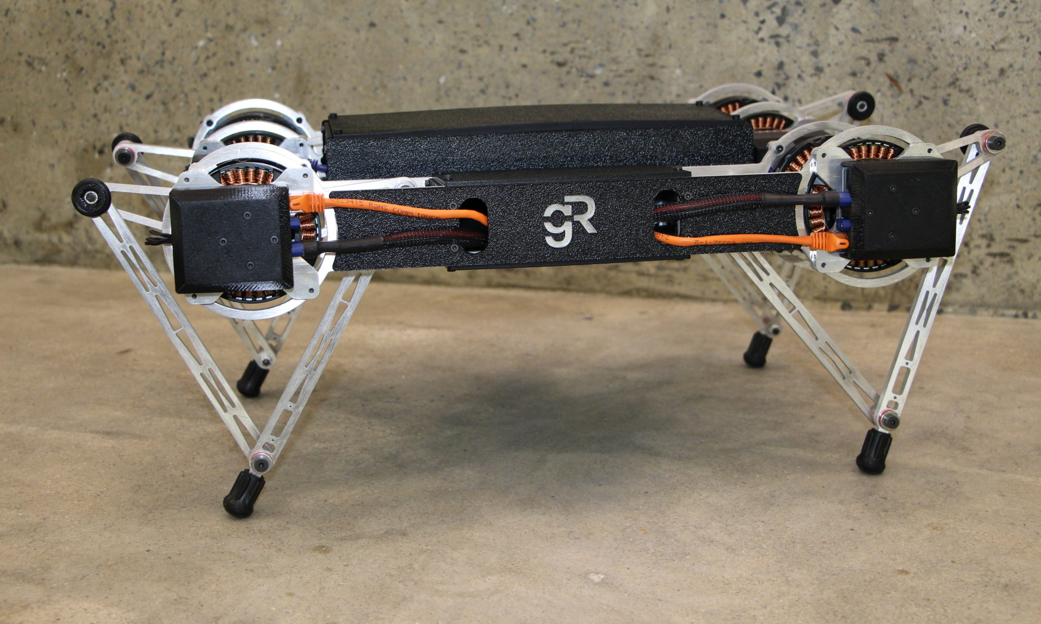
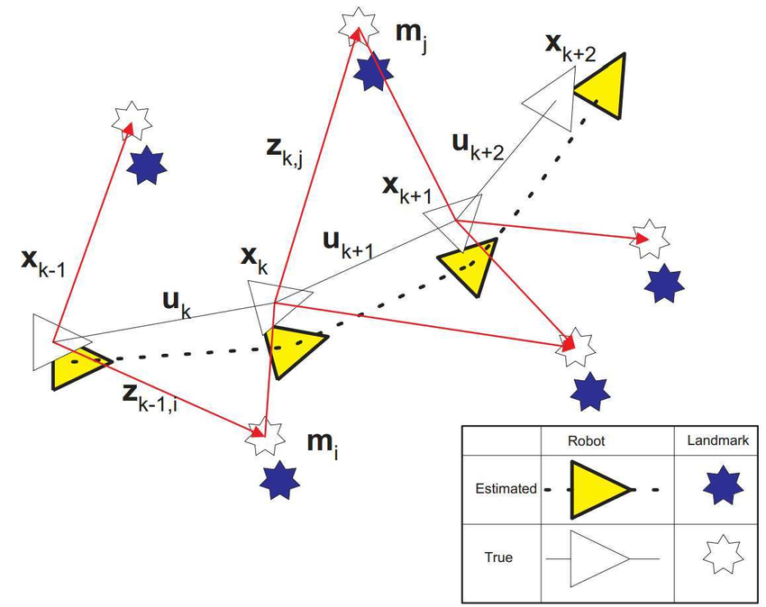
Project Goal
GOAL: Apply iSAM2 to SLAM for Ghost MinitaurTM
SENSORS: ZED stereo camera (including IMU), joint encoders
ZED Mini
stereo camera
Ghost MinitaurTM

Slide 36
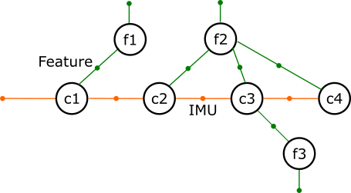
Factor Graph Setup
No priors on features (f₁, f₂, … f_{n}) → Graph unsolvable
To counter-act: set feature priors w/ VERY LARGE covariances

Slide 37
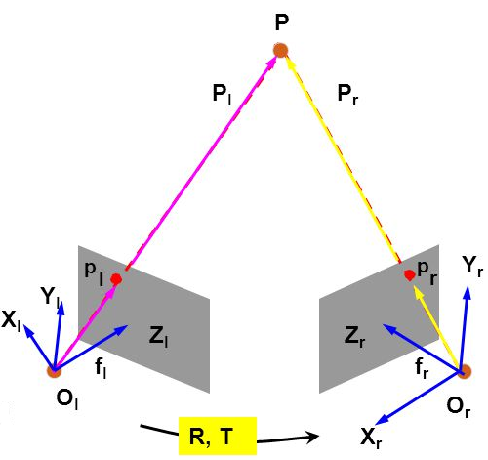
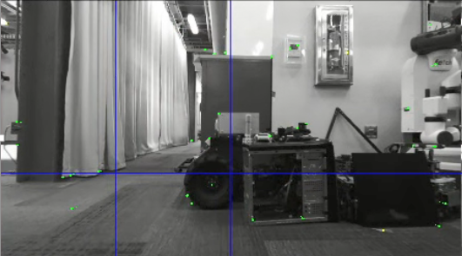
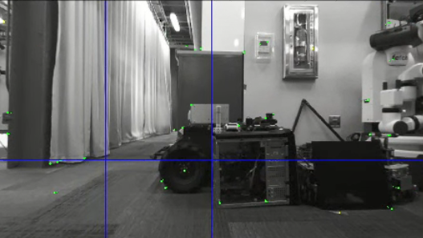
Implementation
P: Landmark in world
1. Estimate camera pose and landmark positions at current time
IMU → change in camera pose
Stereo Camera Images → landmark locations
Camera intrinsics/extrinsics (K, R, T)
Image features (points, corners) → landmarks
2. Use estimate as initial guess at variables, connect related variables by factors
3. Update ISAM2 so that estimates are optimized across entire graph
Z_{l}: Left Image
Z_{r}: Right Image
p_{l}: Feature in
left image
p_{r}: Feature in
right image

Slide 38
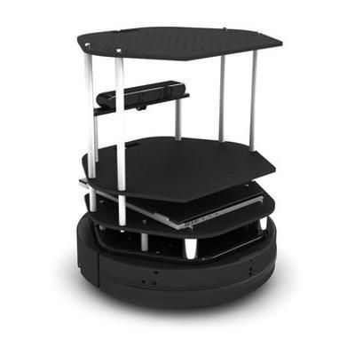
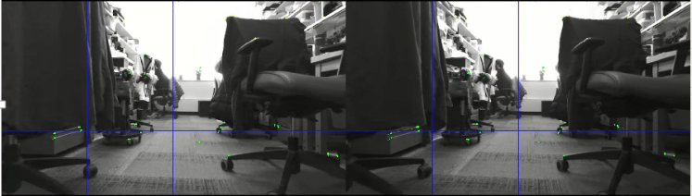
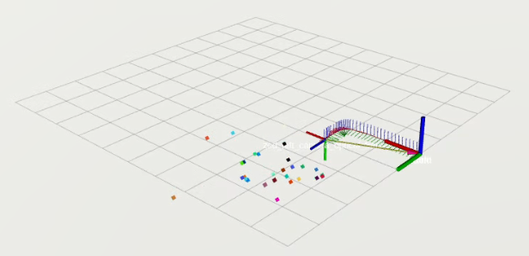
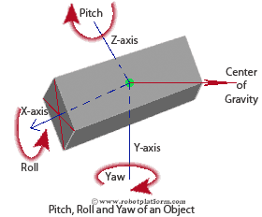
Testing
Test on Turtlebot and visualize in rviz
Left
Camera frame
Right
World frame
Landmarks

Slide 39
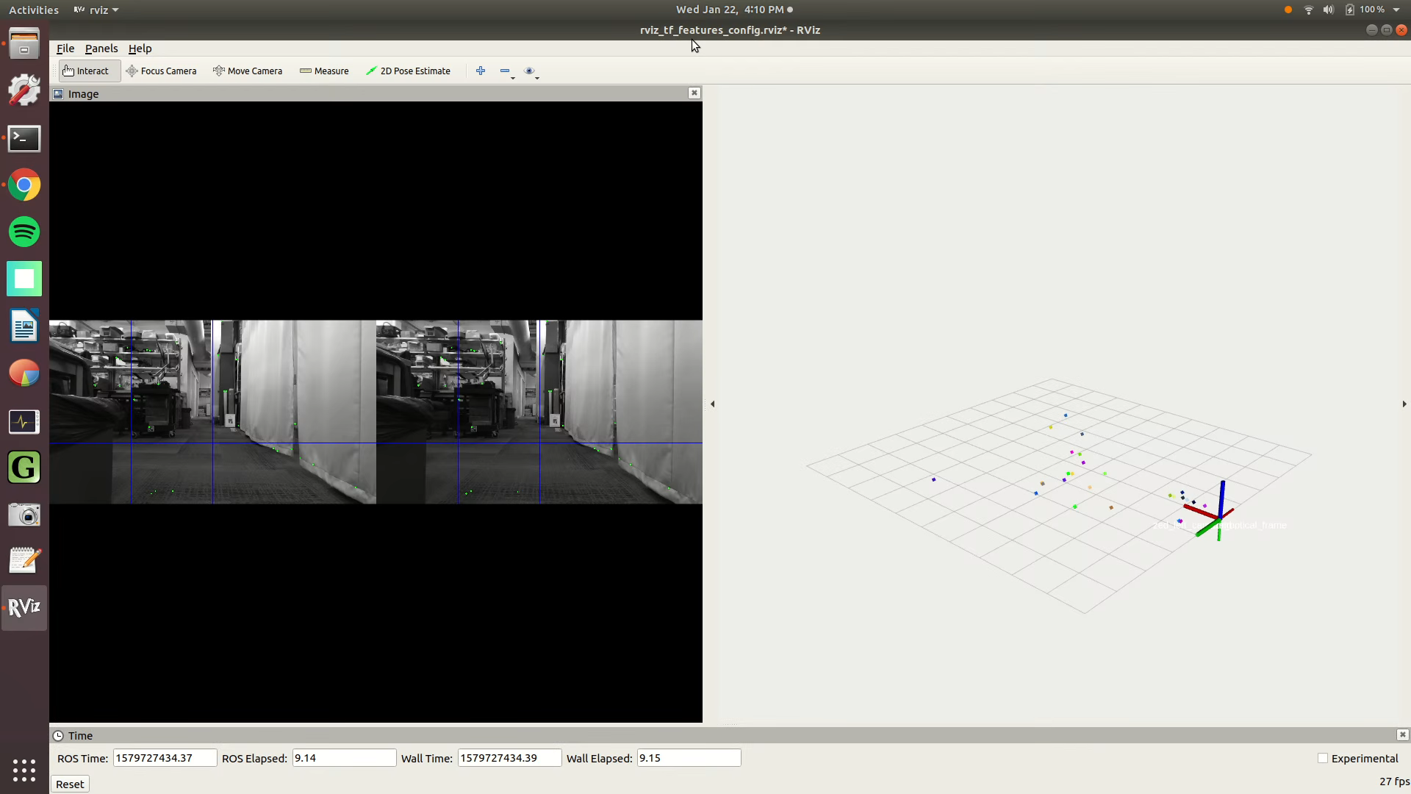
Results: No Turns

Slide 40
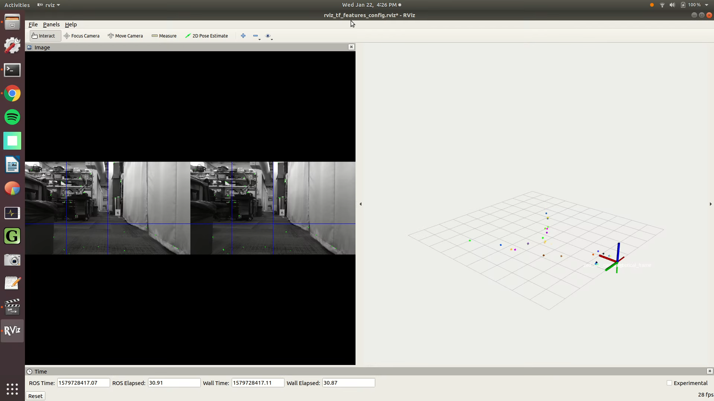
Results: Slow Turns

Slide 41
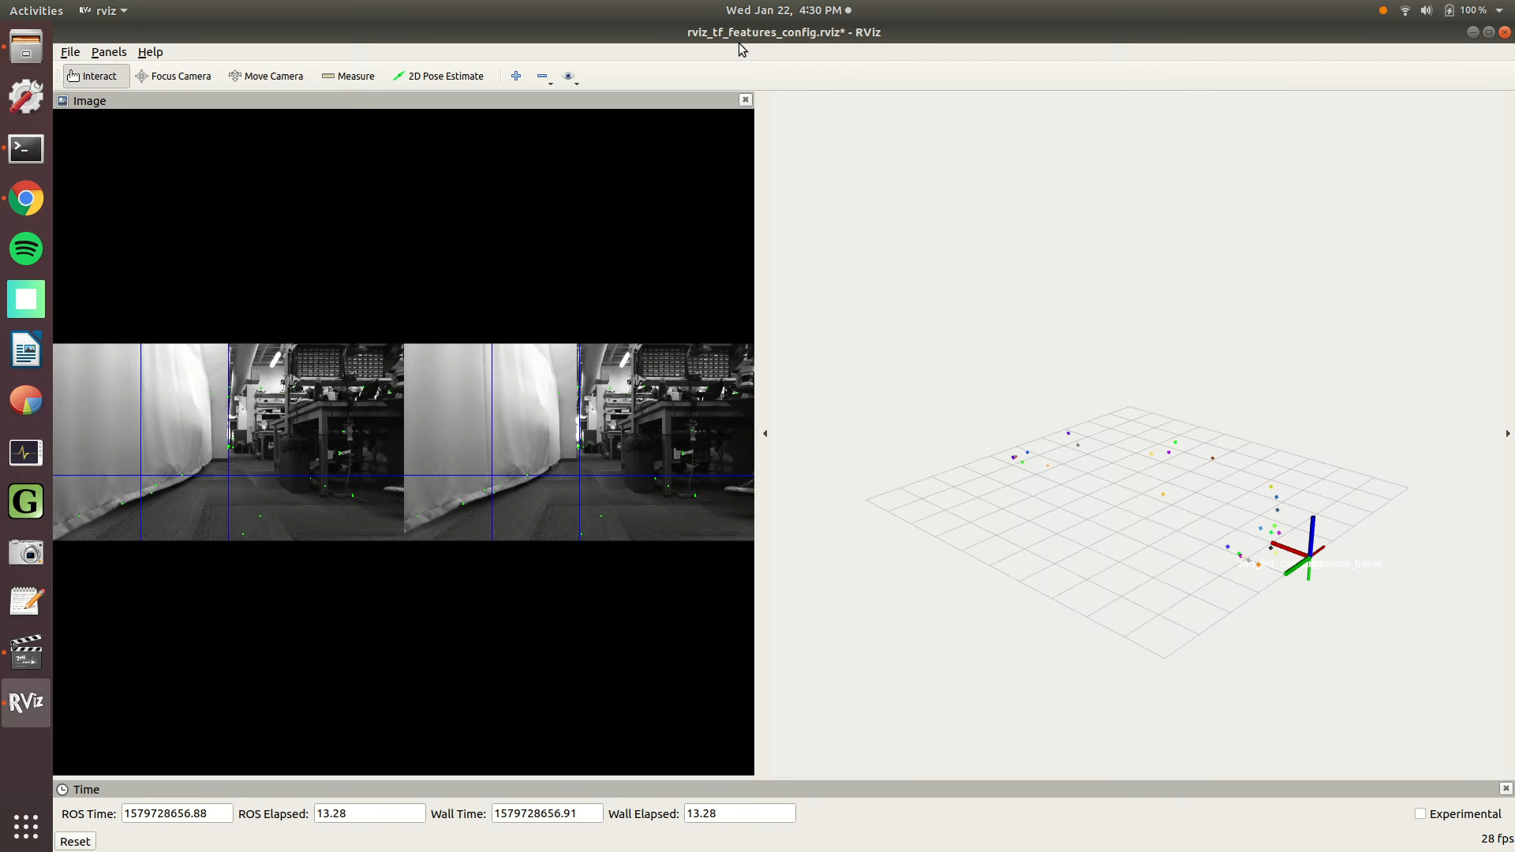
Results: Fast Turns

Slide 42
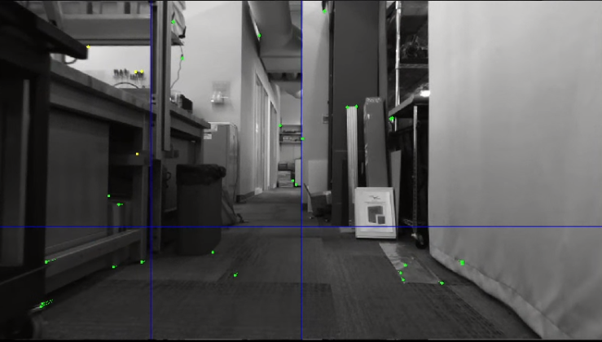
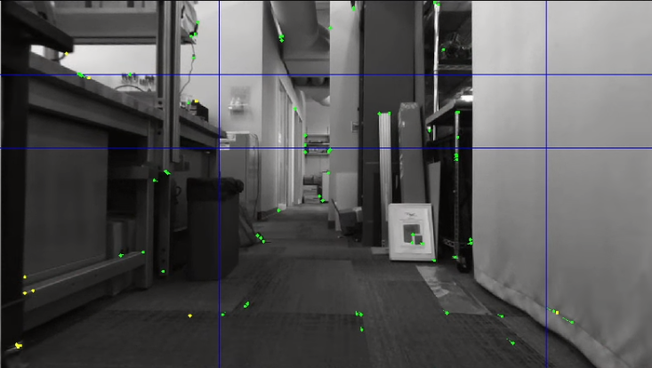
Observations
Graph updates can only happen after program receives messages from camera and image processor
More features = More lagging
Longer wait time between image processor messages
More feature variables → slower iSAM2 update time
3-4 features
per grid cell
3 rows, 4 columns
5 rows, 6 columns

Slide 43

Moving Forward…
Update graph in parallel with adding variables & factors
New image processor
Build custom factors (Hartley 2018)
Forward Kinematic (FK) Factor
Contact Factor

Slide 44
Acknowledgements
Many thanks to my mentor Vasileios Vasilopoulos for his guidance with the development process and assistance with operating the robots.
Thank you also to Dr. Dan Koditschek for providing resources and an inclusive environment in his lab, allowing me to pursue this study over the summer and during the past few semesters.

Slide 45
ReferenceS
Cyrill Stachniss, “Graphical Model Basics”, 2011. URL http://ais.informatik.uni-freiburg.de/teaching/ss11/seminar_pgm/pgm-basics.pdf.
Frank Dellaert, "Factor graphs and GTSAM: A hands-on introduction", 2012.
Frank Dellaert and Varun Agrawal. Gtsam 3.2.1. 2019. URL https://borg.cc.gatech. edu/download.html#download.
Michael Kaess, Hordur Johannsson, Richard Roberts, Viorela Ila, John J Leonard, and FrankDellaert. iSAM2: Incremental Smoothing and Mapping using the Bayes Tree. The International Journal of Robotics Research, 31(2):216–235, 2012.
Ross Hartley, Josh Mangelson, Lu Gan, Maani Jadidi, Jeffrey Walls, Ryan Eustice, and Jessy Grizzle. Legged robot state-estimation through combined forward kinematic and preintegrated contact factors. pages 1–8, 05 2018.

